Slide 1
Writing Using AT: New Research, Strategies, and Tools
Bronwyn Lamond, Francis Wall,
Emily Staffiere & Todd Cunningham
Get the slides at:
www.AcademicInterventionLab.com

Slide 2
Agenda
Overview of AT
Skill deficits associated with writing disabilities
Graphomotor Skills
Typing
Voice Recognition
Idea Generation
Editing Assistance

Slide 3
What is AT?
Notes:
Ask audience:
What their role is?
What experiences do they have with AT?
What’s the first thing they think about when they hear AT?

Slide 4
Assistive Technology is any technology that allows an individual with a disability to increase, maintain, or improve their functional capabilities.
(Edyburn, 2000)

Slide 6
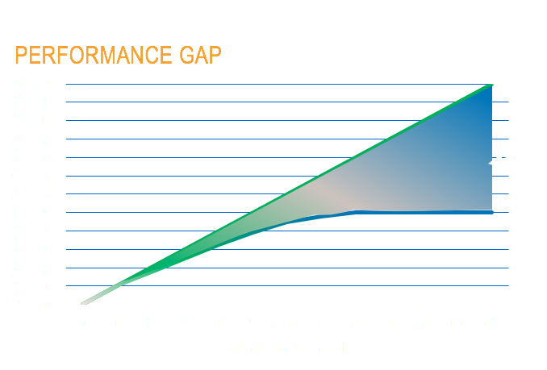
(Stanovich, 1986)

Slide 7
(Todd Cunningham, 2012)
Notes:
AT is not ET

Slide 9
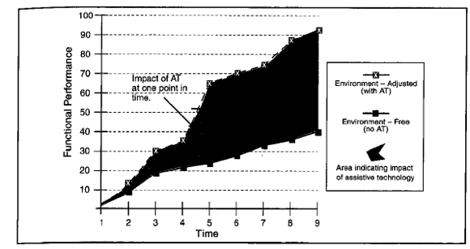
Theoretical view of the role AT can play in an individual’s life.
(Smith, 2000)

Slide 10
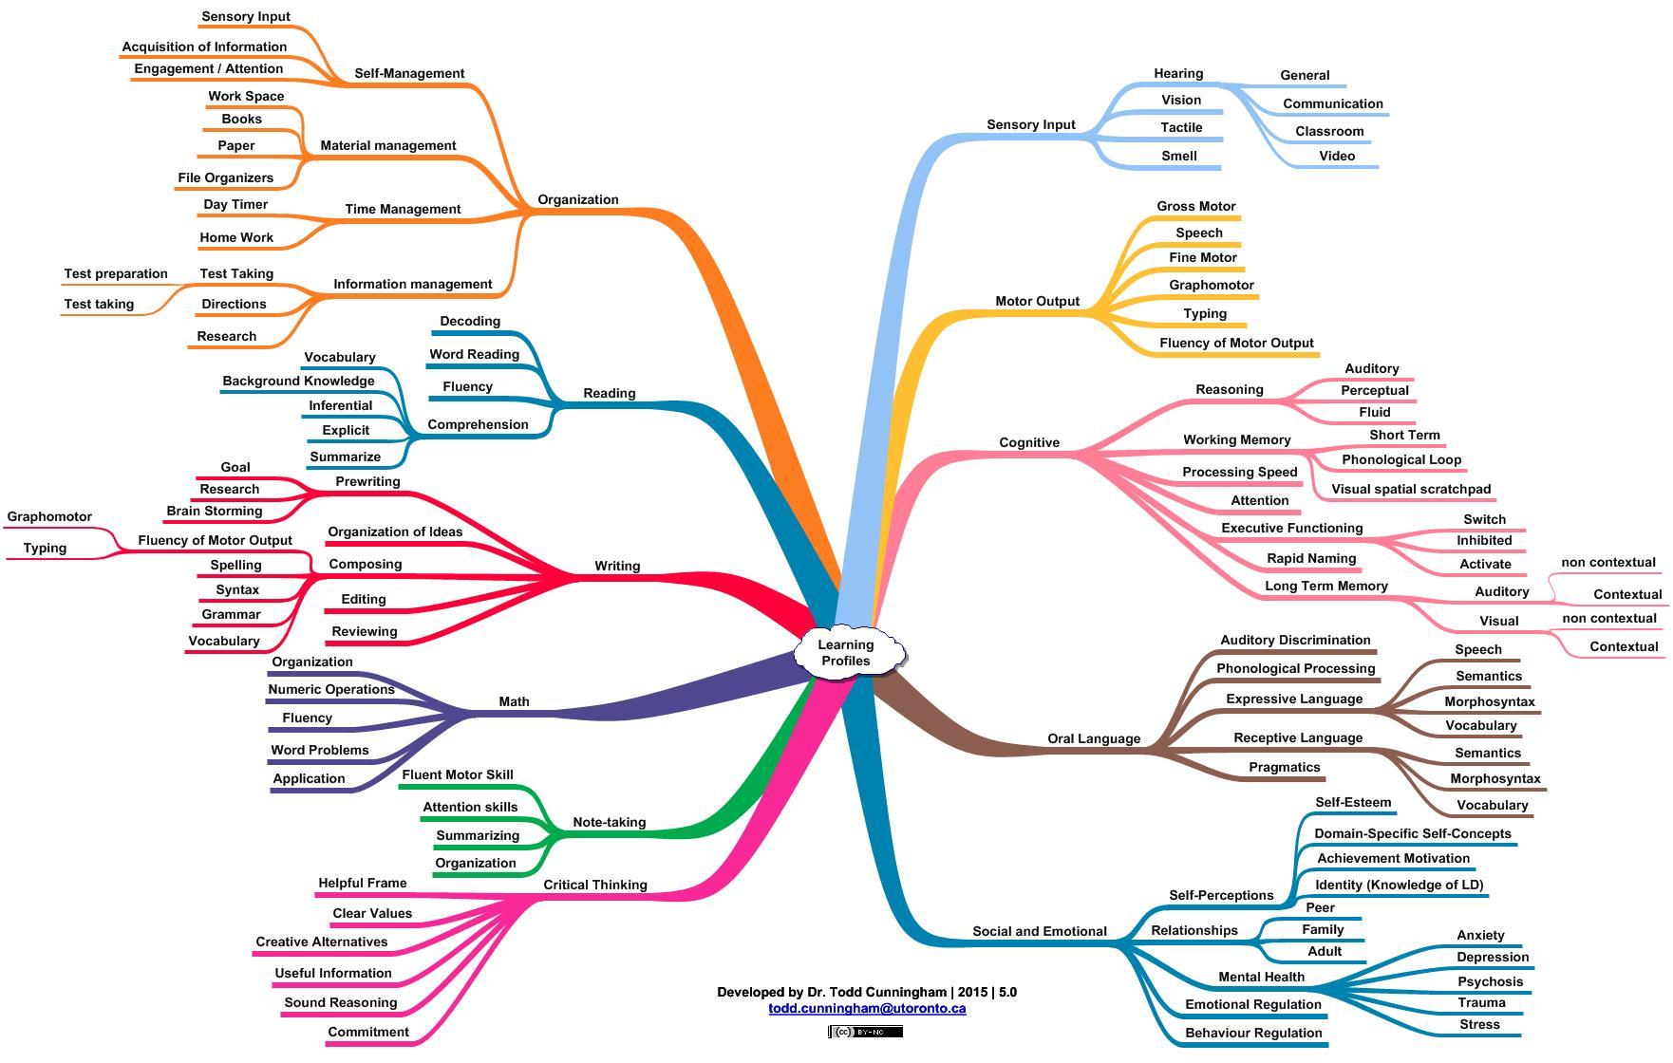
Notes:
**need a clearer picture

Slide 11
What skills impact writing?

Slide 12
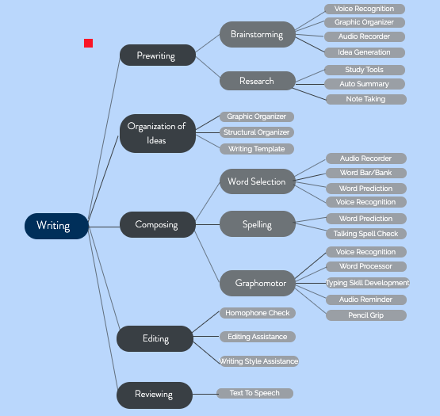
Notes:
Many different component skills

Slide 13
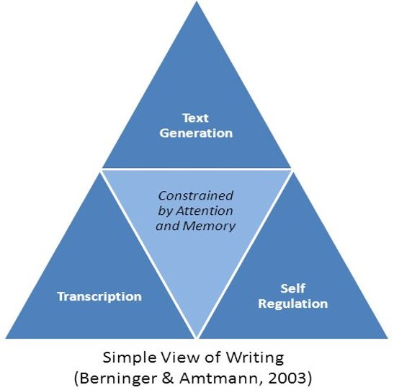
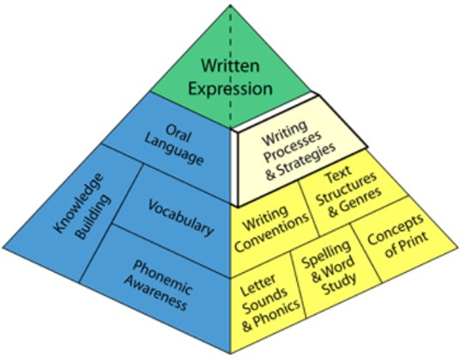
Writing - Component Skills
Quality > quantity
Reading & output
Transcription (graphomotor) skills = foundational
Assistive technology
Kent & Wanzek (2016)
https://www.oise.utoronto.ca/balancedliteracydiet
Notes:
​​Writing model pyramid: shows fundamental pieces to writing at the bottom, with complexity increasing as we go up on the pyramid. i.e. PA is needed before we can build vocabulary to where it need to be and so on. Shows how we understand the logical progression of skill building re: writing to be but we are not as clear cut in our understanding
- tends to be a stronger relationship between the fundamental component skills and writing quality. Still unclear about what impacts the quantity of writing given that the component skills individually are weakly related.​
​
-important that these younger kids are reading if we want them to be able to produce written work, as there is a strong relationship between reading achievement and writing quality. This makes sense because PA is a fundamental component of reading, so the earlier they build this skill the earlier they can produce better written work as this skill also underlies good written expression ​​
-
-We know that these are all component skills to being able to write a piece of work, but to make it easy for us, researchers created the ‘simple view of writing’, that lumps the component skills into three main domains, transcription, self-reg, and text generation (ideas).
-we know that if any component of the simple view of writing is severely impacted than we have less cognitive resources to put towards the other pieces and writing suffers​. For example, Transcription skills are essential – handwriting fluency, typing output; any means to get writing down on paper. The more cognitive resources one has to focus on producing the written text (i.e. physically holding a pencil) then the less resources they have to come up with new ideas and stay motivated to write.
​
●DCD website – all you need to have is a functional signature – looks the same every time; everything else is digital​
●AT one option to help circumvent difficulties in this area

Slide 14
Typing Skill Development
Notes:
As a compensatory strategy for addressing writing challenges, we often turn to typing as our "band-aid" solution but there are many unresolved aspects with typing in the literature. → Skill that needs to build so that the AT can be put into place ​

Slide 15
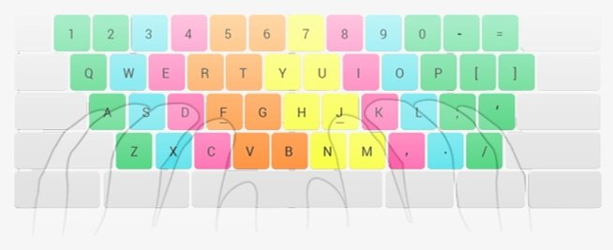
Keyboarding Activity
Keyboard Activity
When the sunlight stries raindrops in the air, they act as a prism and form a rainbow. Fairbanks (1960)
COPY: When the sunlight strikes rindrops in the air, the air, they act as a prism and form a rianbow

Slide 16
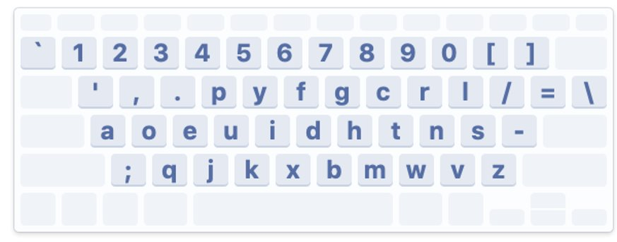
Keyboard Activity
When the sunlight strikes raindrops in the air, they act as a prism and form a rainbow. Fairbanks (1960)
COPY: when

Slide 17
Typing Development
Automaticity is key
Average of 20 WPM for proficiency (non-LD)
Typing speed increases with age
LD students make more revisions
Needing updates
Notes:
-typing can only be an effective alternative to handwriting when proficiency is achieved (Preminger, Weiss & Weintraub, 2004) and one can keyboard at least as fast as they can handwrite (Dunn & Reay, 1989). ​
-- automaticity --> improves writing fluency and subsequent writing quality as their cognitive load for transcription lessens to allow more resources for text generation.
○​research tells us that 20 WPM = bare minimum WPM because still spending too much time on the keyboard; entry point into using the technology ​
■Study done in 1999 that showed that for grade 8 students, if they typed at speeds of 20 WPM or more, they produced better quality responses to open-ended test questions than if they handwrote their answers
■But for students typing at less than 20 WPM thre were negative performance effects on their response quality
○55 WPM benchmark for the people who type for a living – (study done in the 80s) ​
○Need to push higher to fully compensate for the transcription challenges ​
- appears to be a trend emerging that typing speed increases with age (Berninger et al., 2009). ​​

Slide 18
Voice Recognition
Notes:
Another AT that we can use to circumvent the difficulties experienced by those with writing challenges
Ask the audience:
-Why do we use VR?
-What VR programs do you use?
-What works well for you?
Have you had any challenges?

Slide 19
VR can:
Recognize and translate spoken language into written text
Enable the user to:
Talk naturally to the computer, which will record exactly what they said as text
Speak commands enabling hands-free computing
Notes:
Also called voice typing, voice dictation, speech to text
Can be used to transcribe spoken word into written text
The program recognizes words being spoken, and using computer software, can produce written text output of what was said

Slide 20
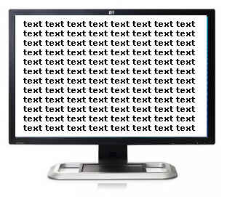
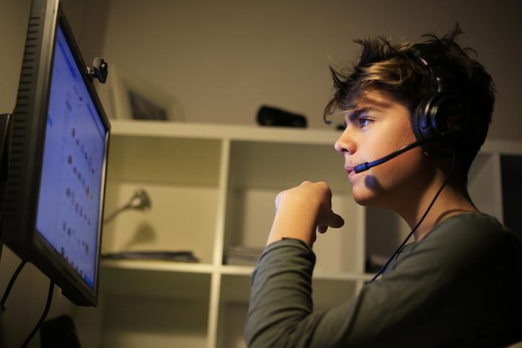
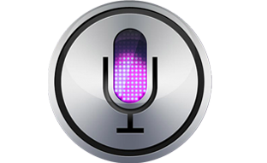
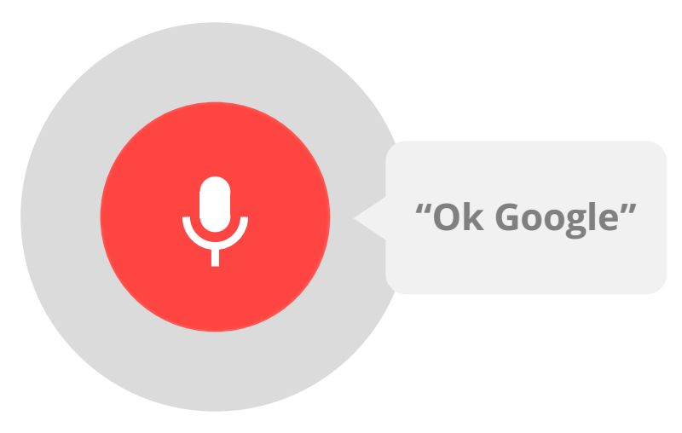
Voice Recognition (VR)
Notes:
Some softwares are server-side (voice is sent to the server, where it is analyzed using the pre-existing data in the database, and then returns to the computer where it is transcribed - ex. Google, Apple, Microsoft)
some are client-side (the software itself creates a database of sounds specific to the individual user through a speech training exercise. It uses the training to create a profile with files on the type of microphone you use, custom words and sounds, and vocabulary.)

Slide 21
Let’s try it!
Notes:
Ask the audience:
Why do we use VR?
What VR programs do you use?
What works well for you?
Have you had any challenges?

Slide 22
When the sunlight strikes raindrops in the air they act as a prism and form a rainbow Fairbanks 1960
4s delay
Speak clearly
Say the punctuation
Notes:
***When the sunlight strikes raindrops in the air they act as a prism and form a rainbow Fairbanks 1960

Slide 23
Voice Recognition Mini-Study (November 2019)
Passage
Voice Recognition Softwares
Error Types
Rainbow passage
Omission
Addition
Substitution
Grammar (“pass” vs. “passed)
Homophone (“two” vs. “to”)
Punctuation
Capitalization
MS Word, MS Cortana, Google Docs, Mac iOS, Dragon 15
Standardized: Mic distance, reading pace, audio files

Slide 24
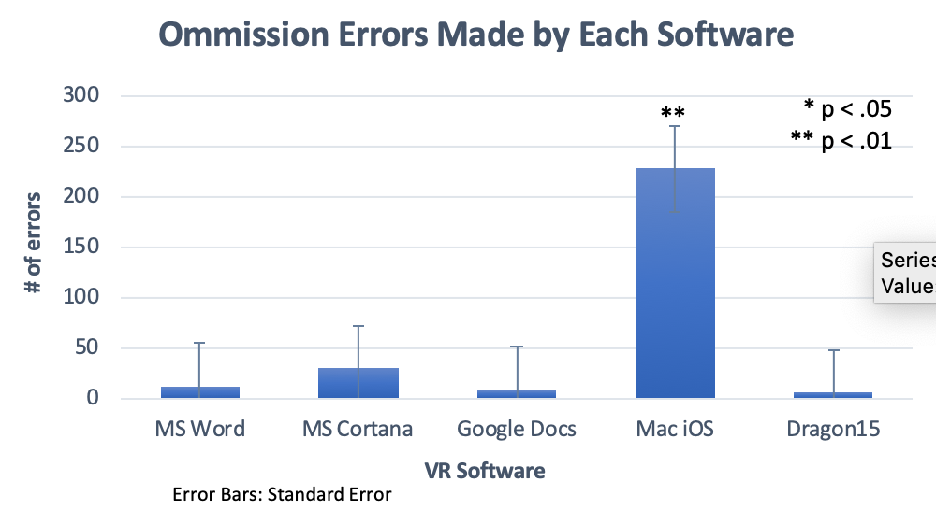
Notes:
Mac sig more than the rest
No sig differences between the others

Slide 25
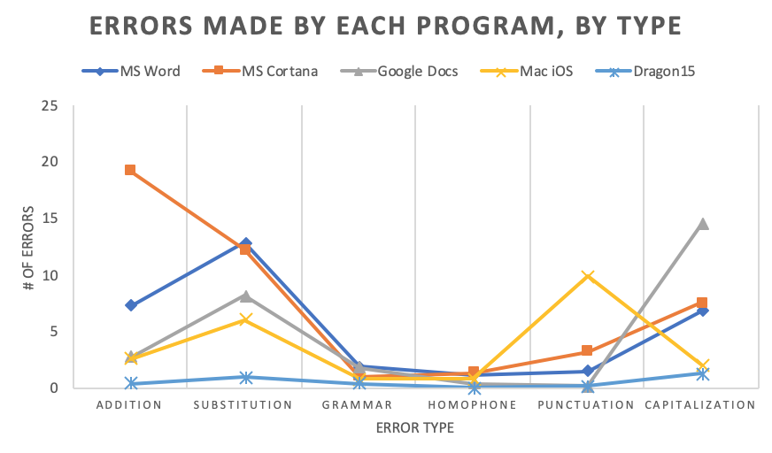
Notes:
A lot of variability in the amount of errors, and the amount of each type of errors that the softwares are making
Going to focus in on the 4 with more scatter in their sections

Slide 26
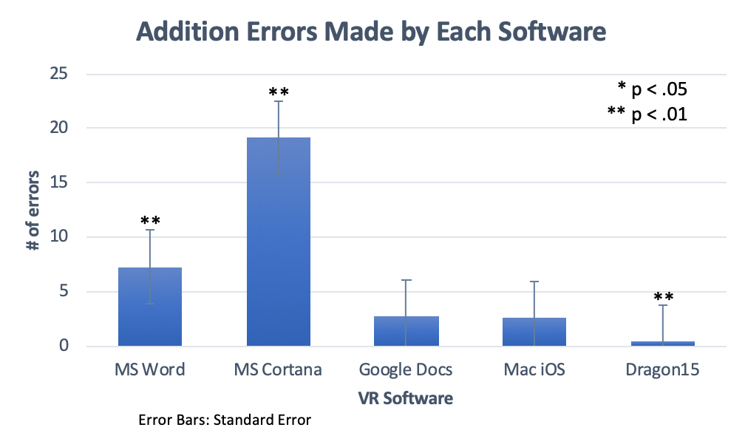
Notes:
Word - sig less than Cortana, sig more than the rest
Cortana - sig more than the rest
Dragon - sig less than all BUT mac

Slide 27
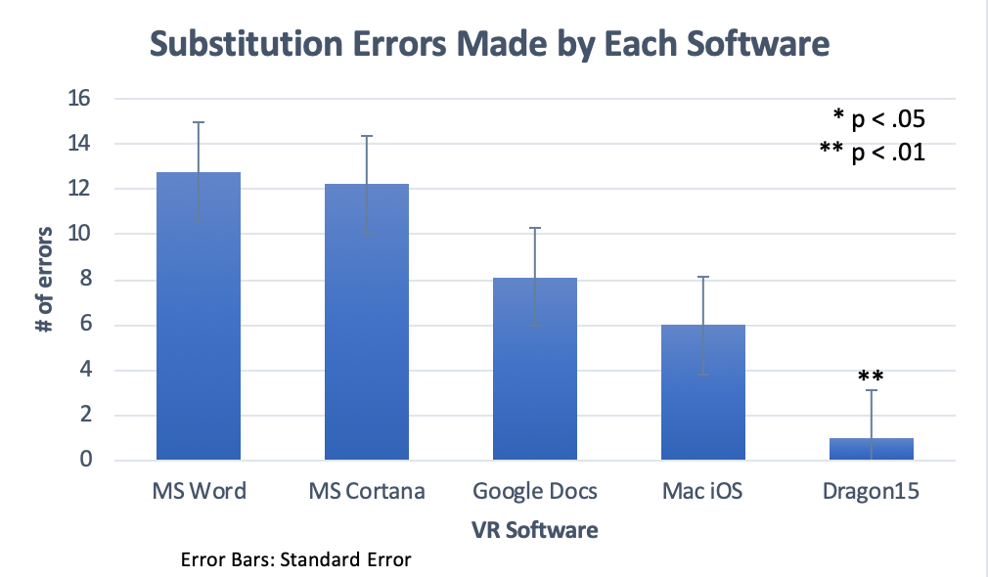
Notes:
Word - sig more than mac and dragon
Cortana - sig more than mac and dragon
Google Docs - sig more than Dragon
No sig diff between mac and dragon
**no sig diff between mac and dragon, but the first three were sig more than dragon, only google docs not sig more than Mac

Slide 28
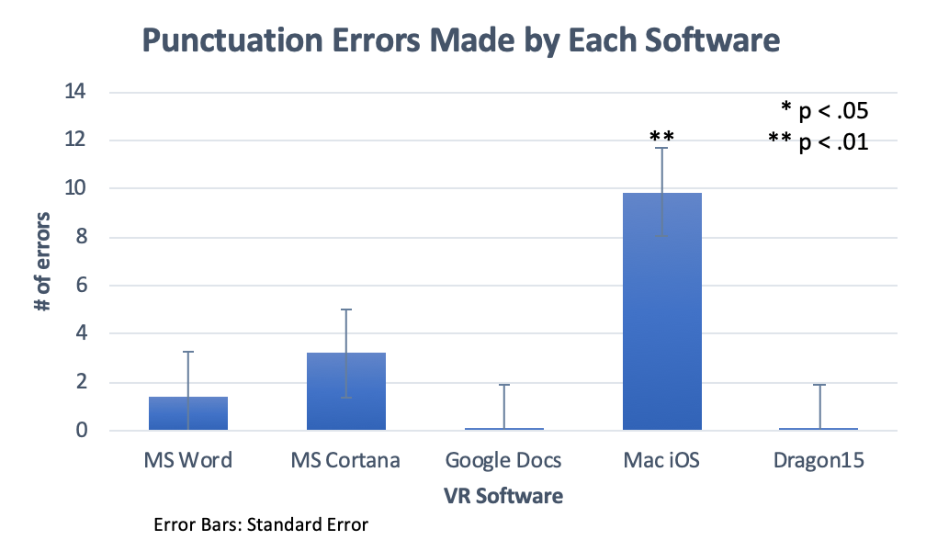
Notes:
Punctuation Errors
Word - sig more than google docs & Dragon
Mac sig more than all but cortana

Slide 29
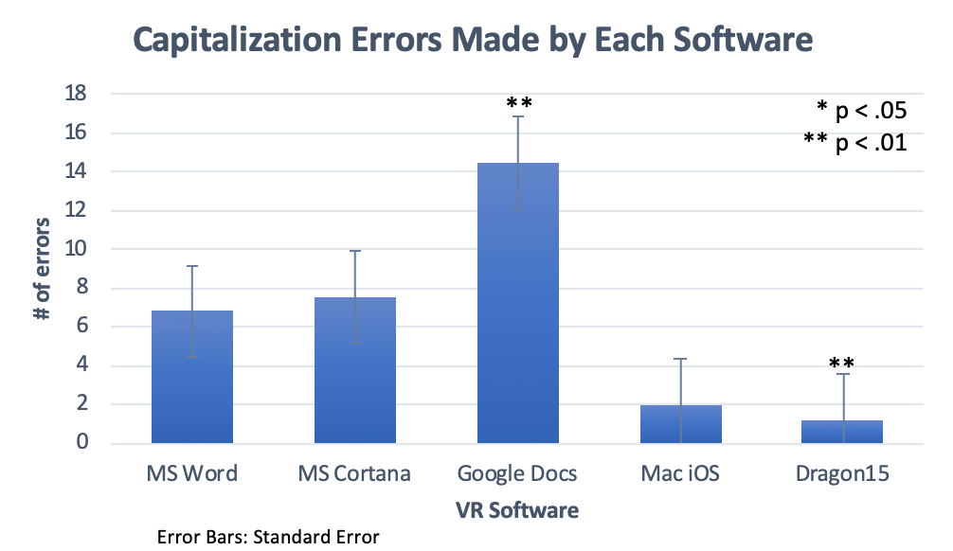
Notes:
Capitalization Errors
Word - sig less than docs, more than mac & Dragon
Cortana - sig less than docs; sig more than mac and dragon
Google docs - sig more than ALL
Dragon - sig less than all but mac

Slide 30
Taming the Dragon - v15
Various Dragon products suited for different productivity needs
Allows users to “train” program to recognize their voice, word pronunciation, and speech patterns
Notes:
Osapac - buys software for english and french public schools - bought dragon 11 for a lot of schools
Dragon 11 - don’t use!!
30-45 mins to train the program
More sophisticated (offers more functions)
“trained” to recognize the speaker’s pronunciation and speech patterns
Using voice commands to edit writing
doi: 10.1080/03069400.2014.914732
The training process helps the software personalize interpretation of the spoken word. The initial training process takes place before you begin using the software. You may be asked to identify your age, gender and regional origin. You will be asked to read one of the proscribed pieces of literature (from a children’s book to Kennedy’s inaugural address) for up to four minutes. You can add frequently used words to the VRS vocabulary with additional training (Collins, 2014)

Slide 31
Voice Recognition (VR) Mini Study (August 2017)
Notes:
In this study, we are comparing vr performance for different programs in different internet environment. Using the rainbow passage. Client side program is Dragon v15. Server side Google Talk and Type. HS - high speed. LS - low speed. Clear - clear cache. Preloaded - cache that had already done the condition before.
M - average number of errors when we ran them through the different programs in the different conditions.

Slide 32
Classroom Challenges
Notes:
VR if possible in classroom - need a quiet classroom though and strong executive functioning ability to go back and revise text/errors

Slide 33
Idea Generation

Slide 34
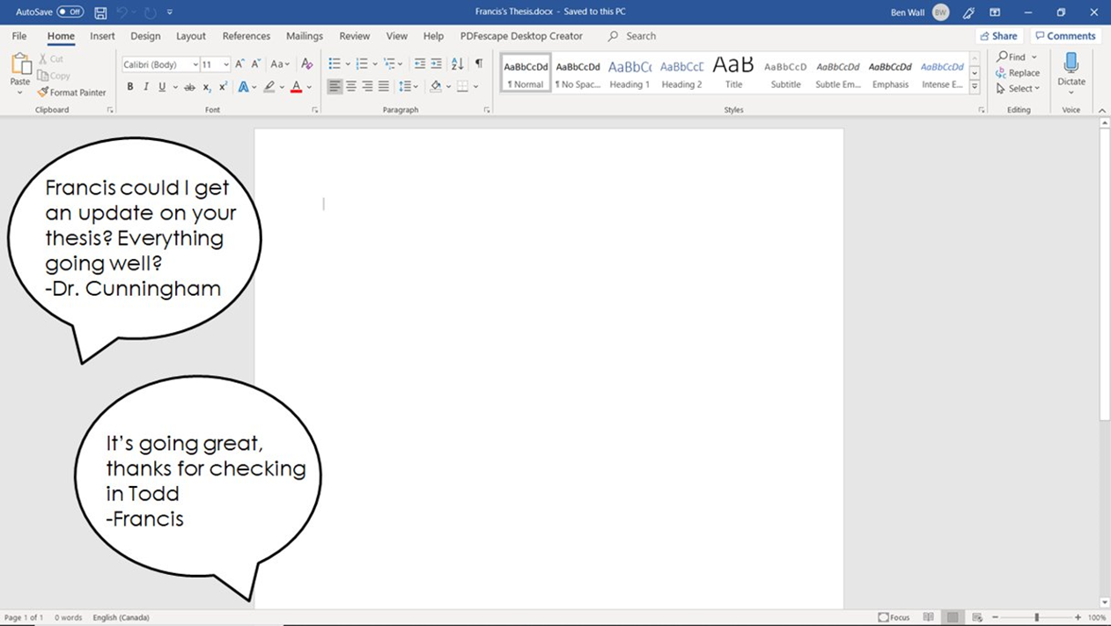

Slide 35
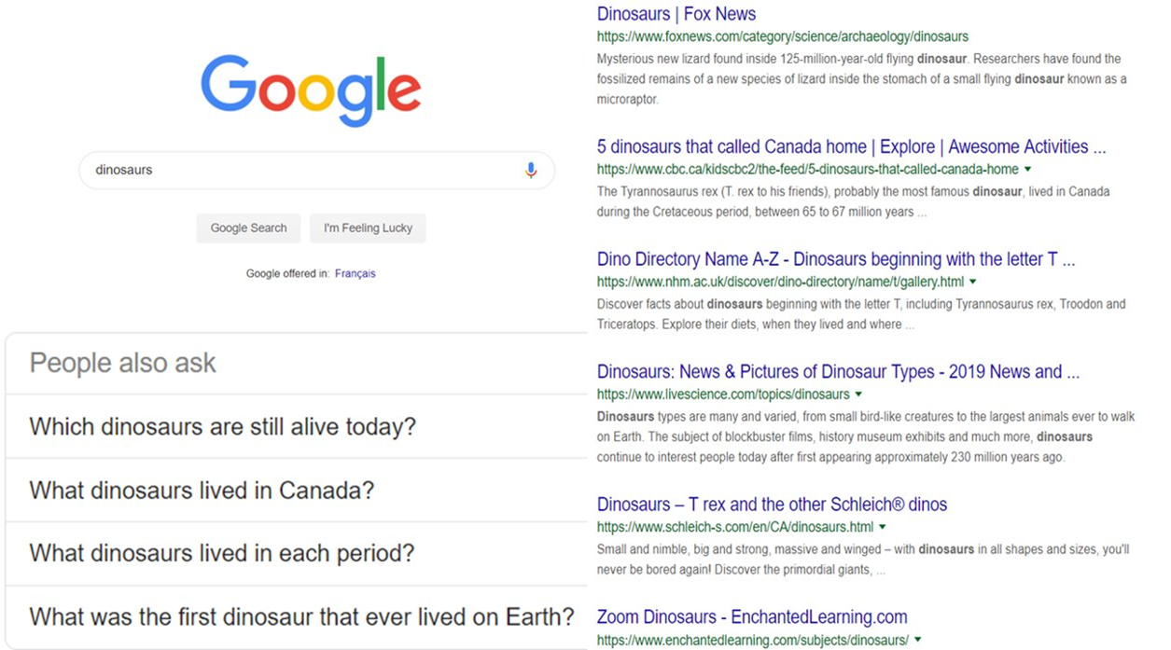

Slide 36
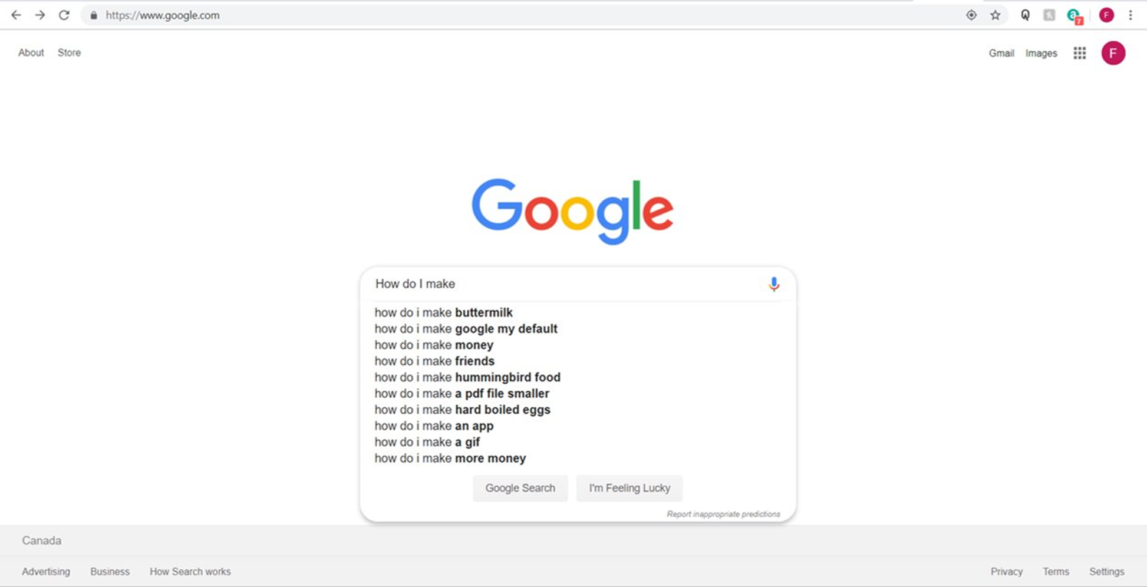

Slide 37
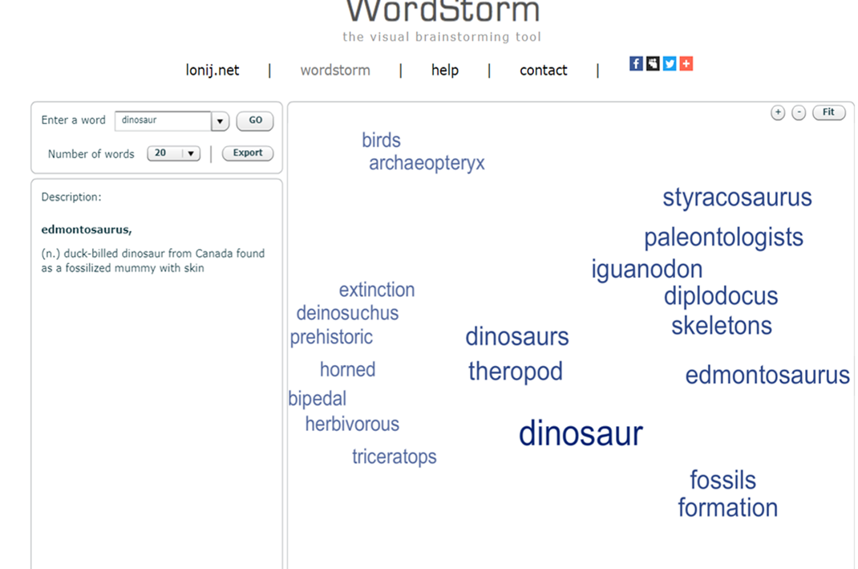

Slide 38
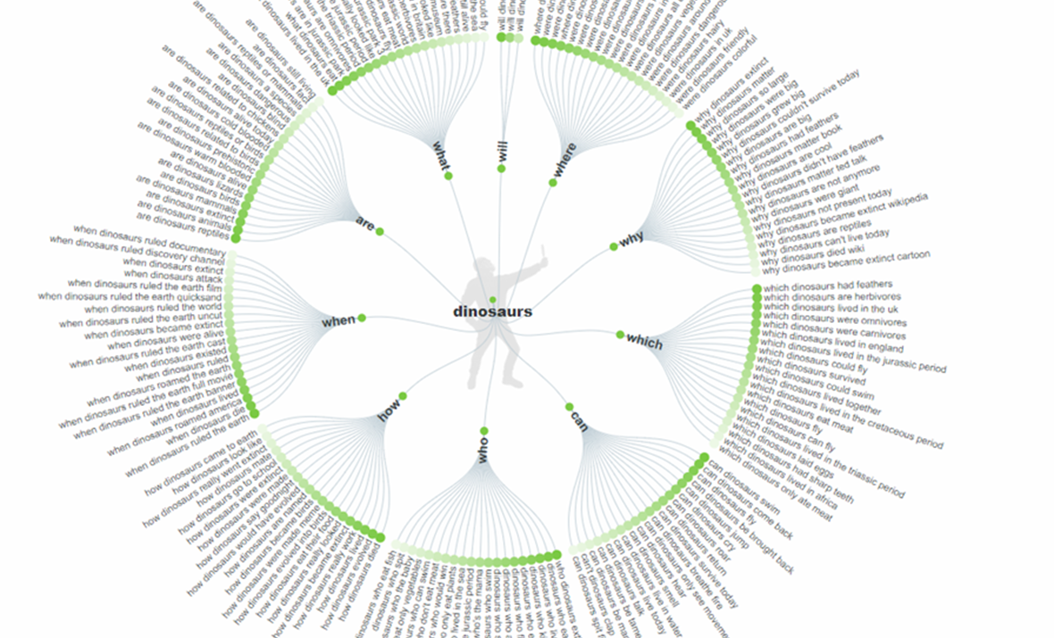

Slide 39
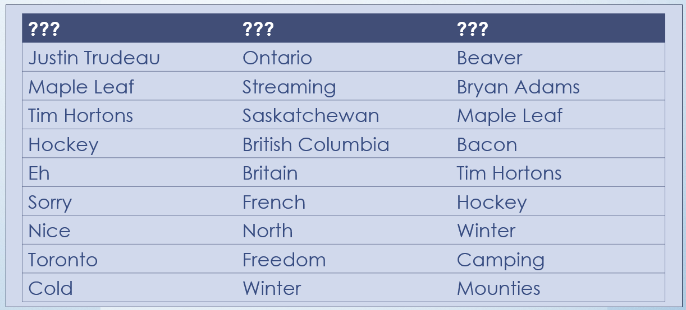
CANADA

Slide 40
CANADA

Slide 41
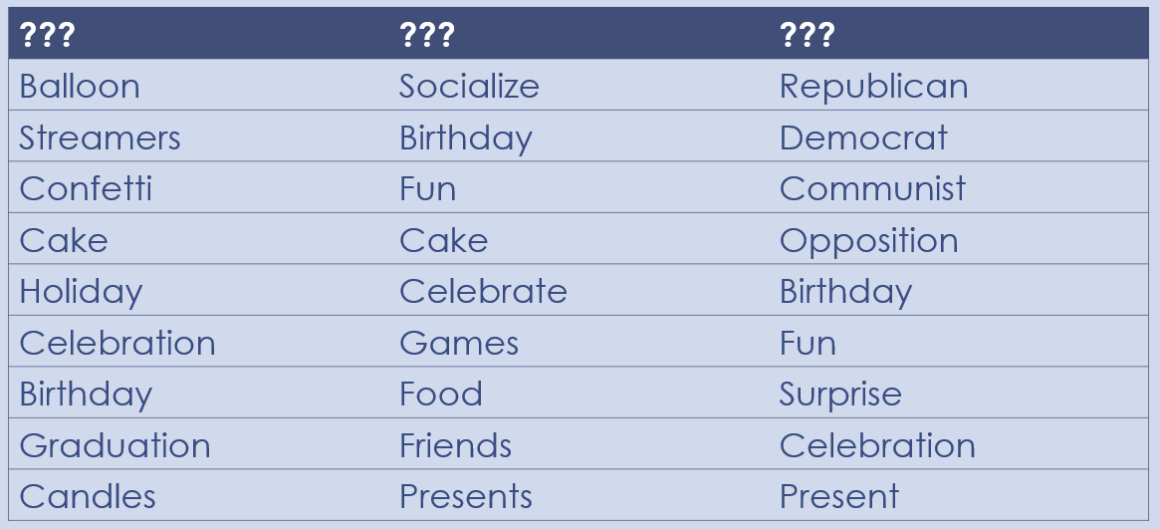
PARTY

Slide 42
PARTY

Slide 43
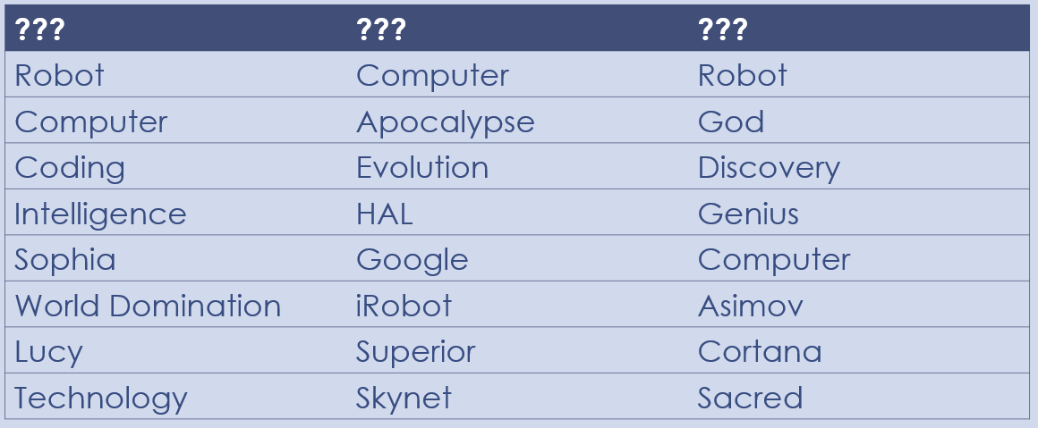
ARTIFICIAL INTELLIGENCE

Slide 44
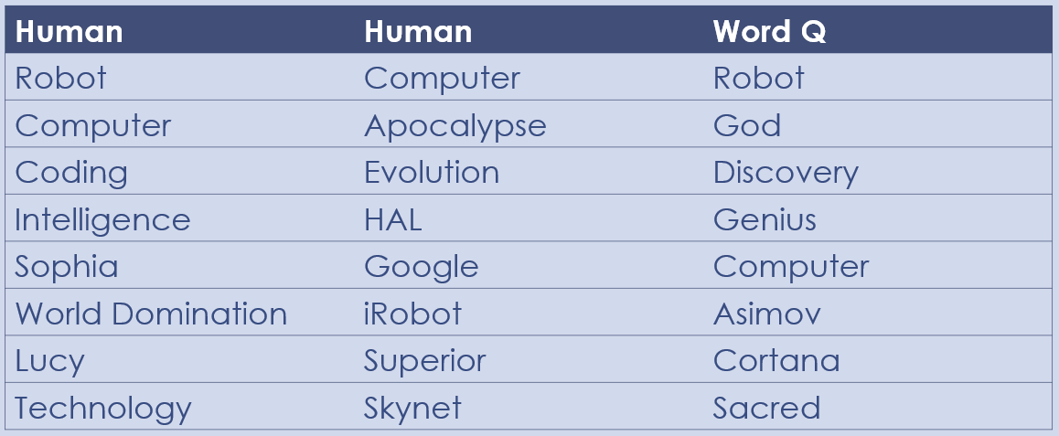
ARTIFICIAL INTELLIGENCE

Slide 45
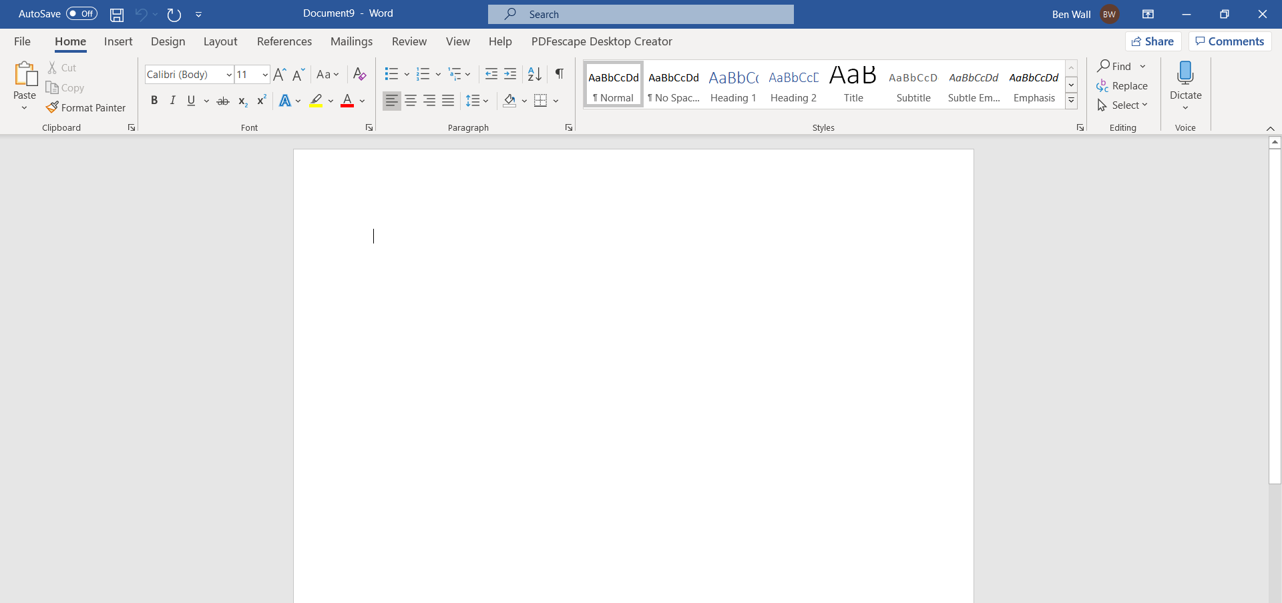
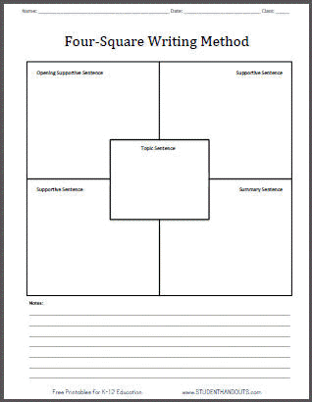
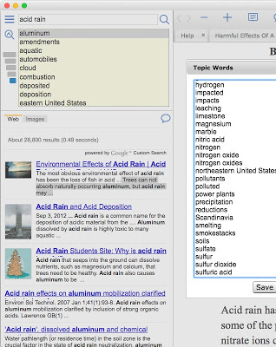
Control
Strategy
Technology
Combined

Slide 46
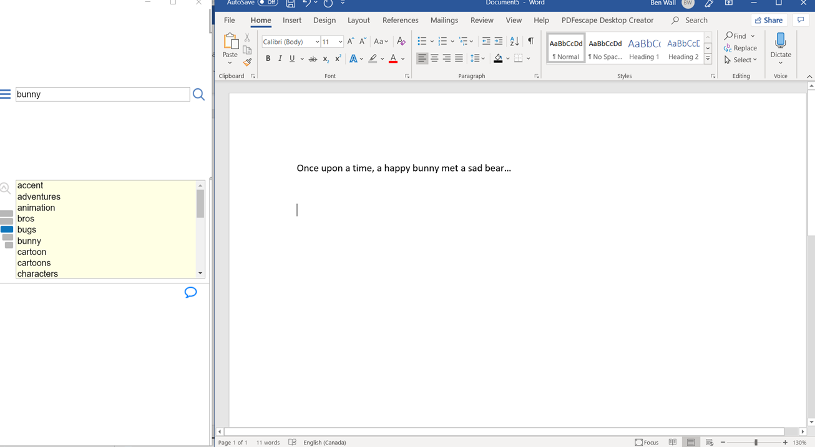
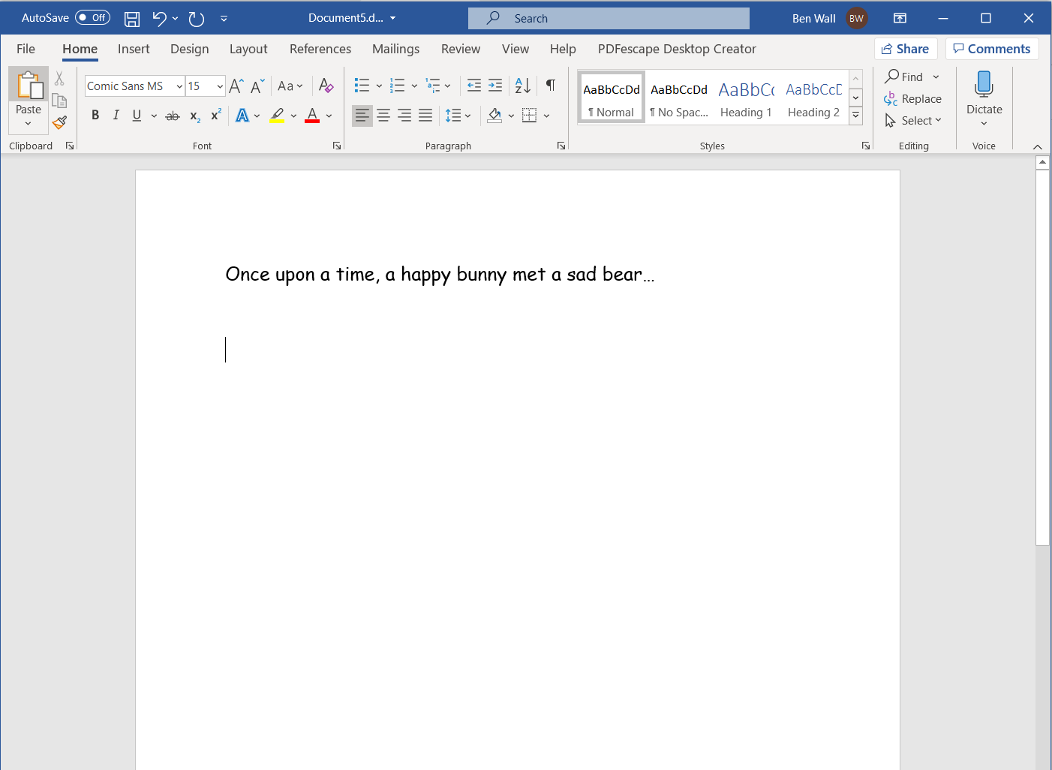
Bunny -> Adventure

Slide 47
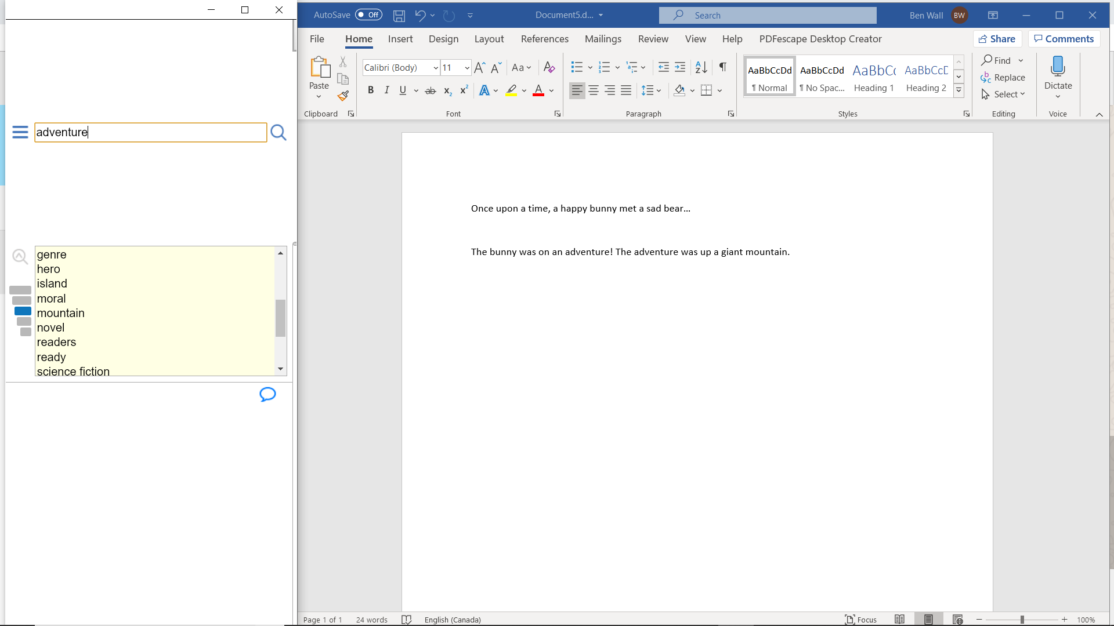
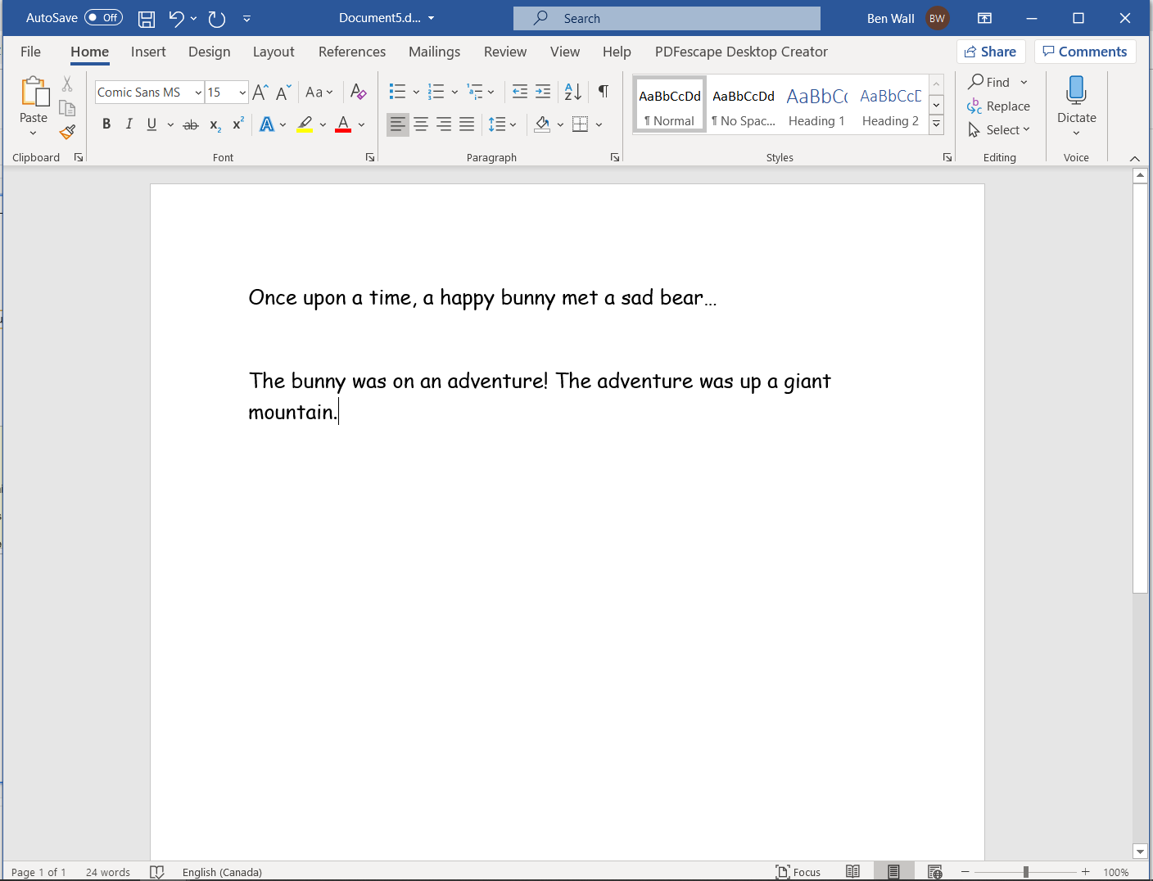
Adventure -> Mountain

Slide 48
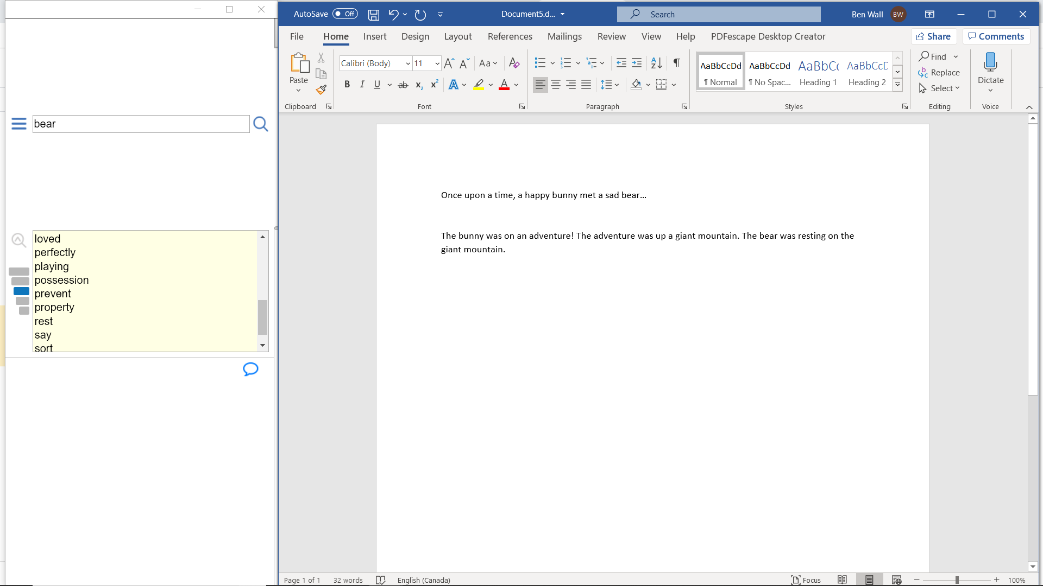
Bear -> Rest

Slide 49
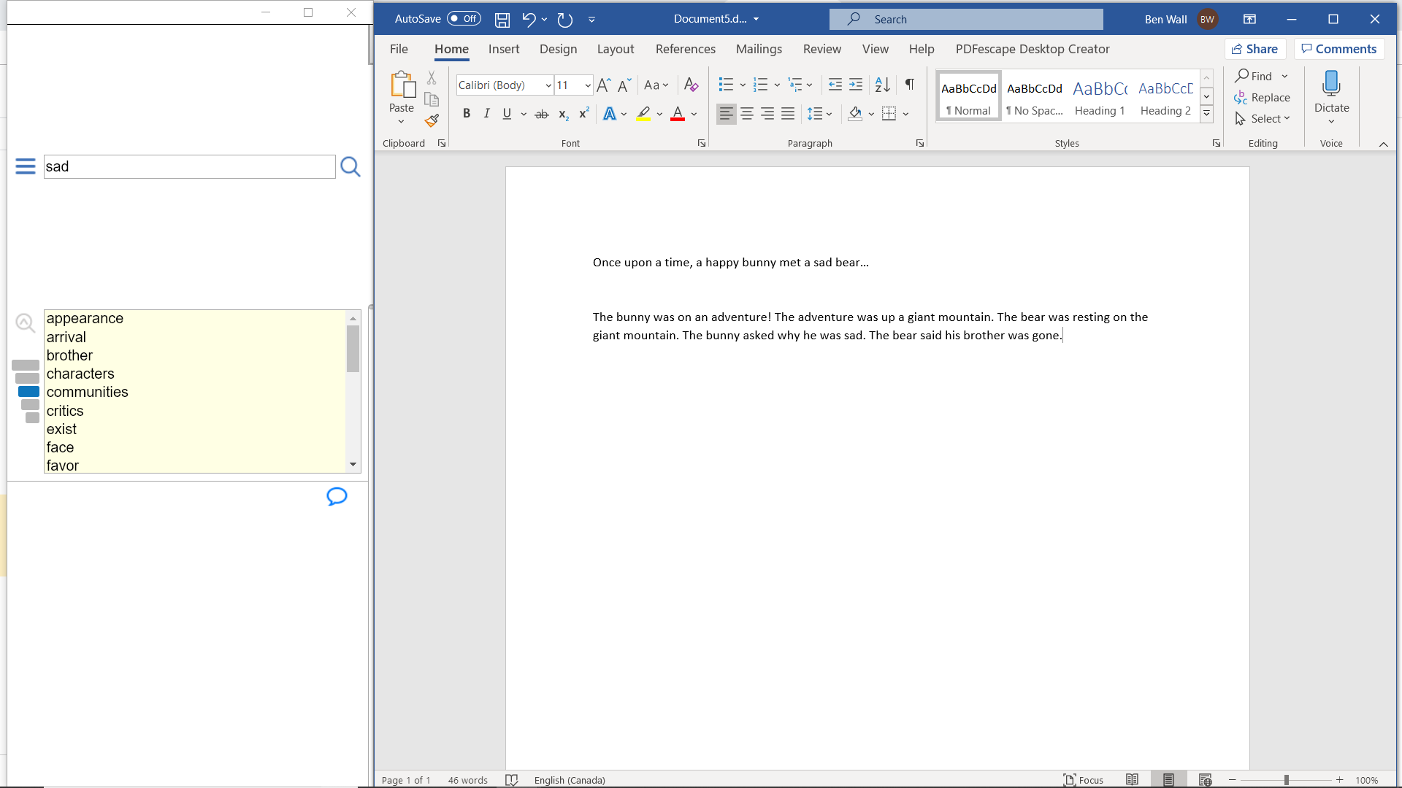
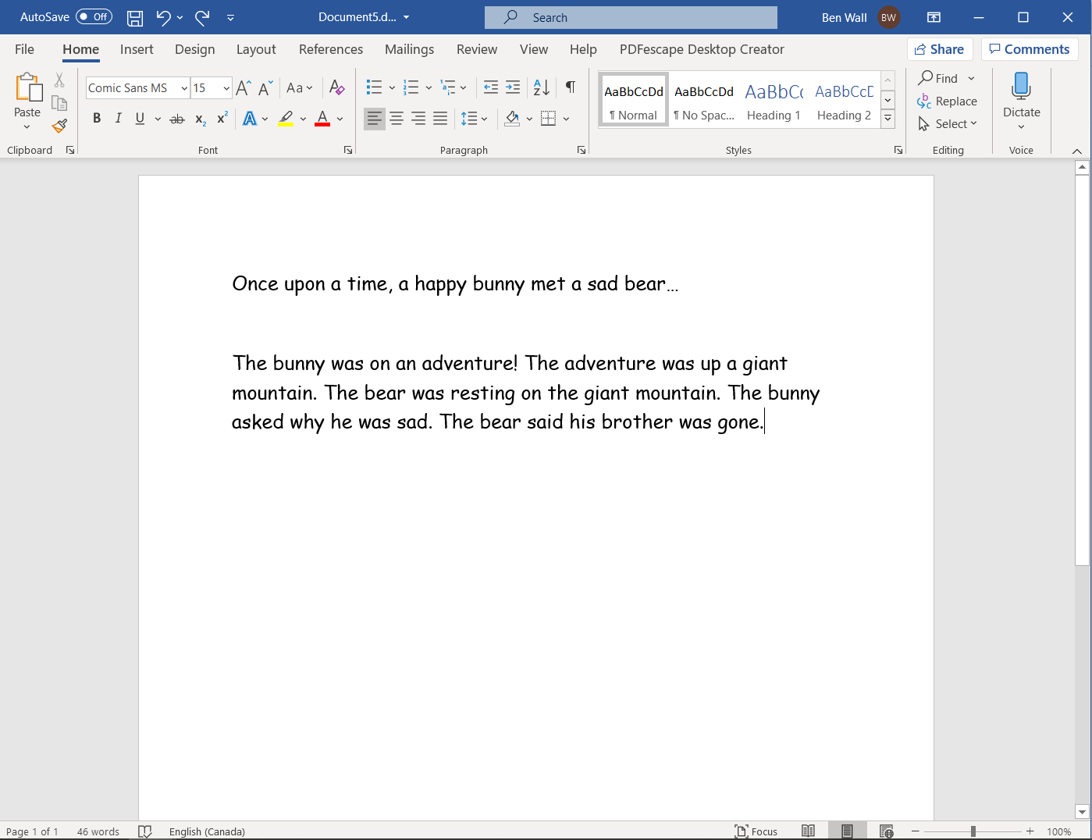
Sad -> Brother

Slide 50
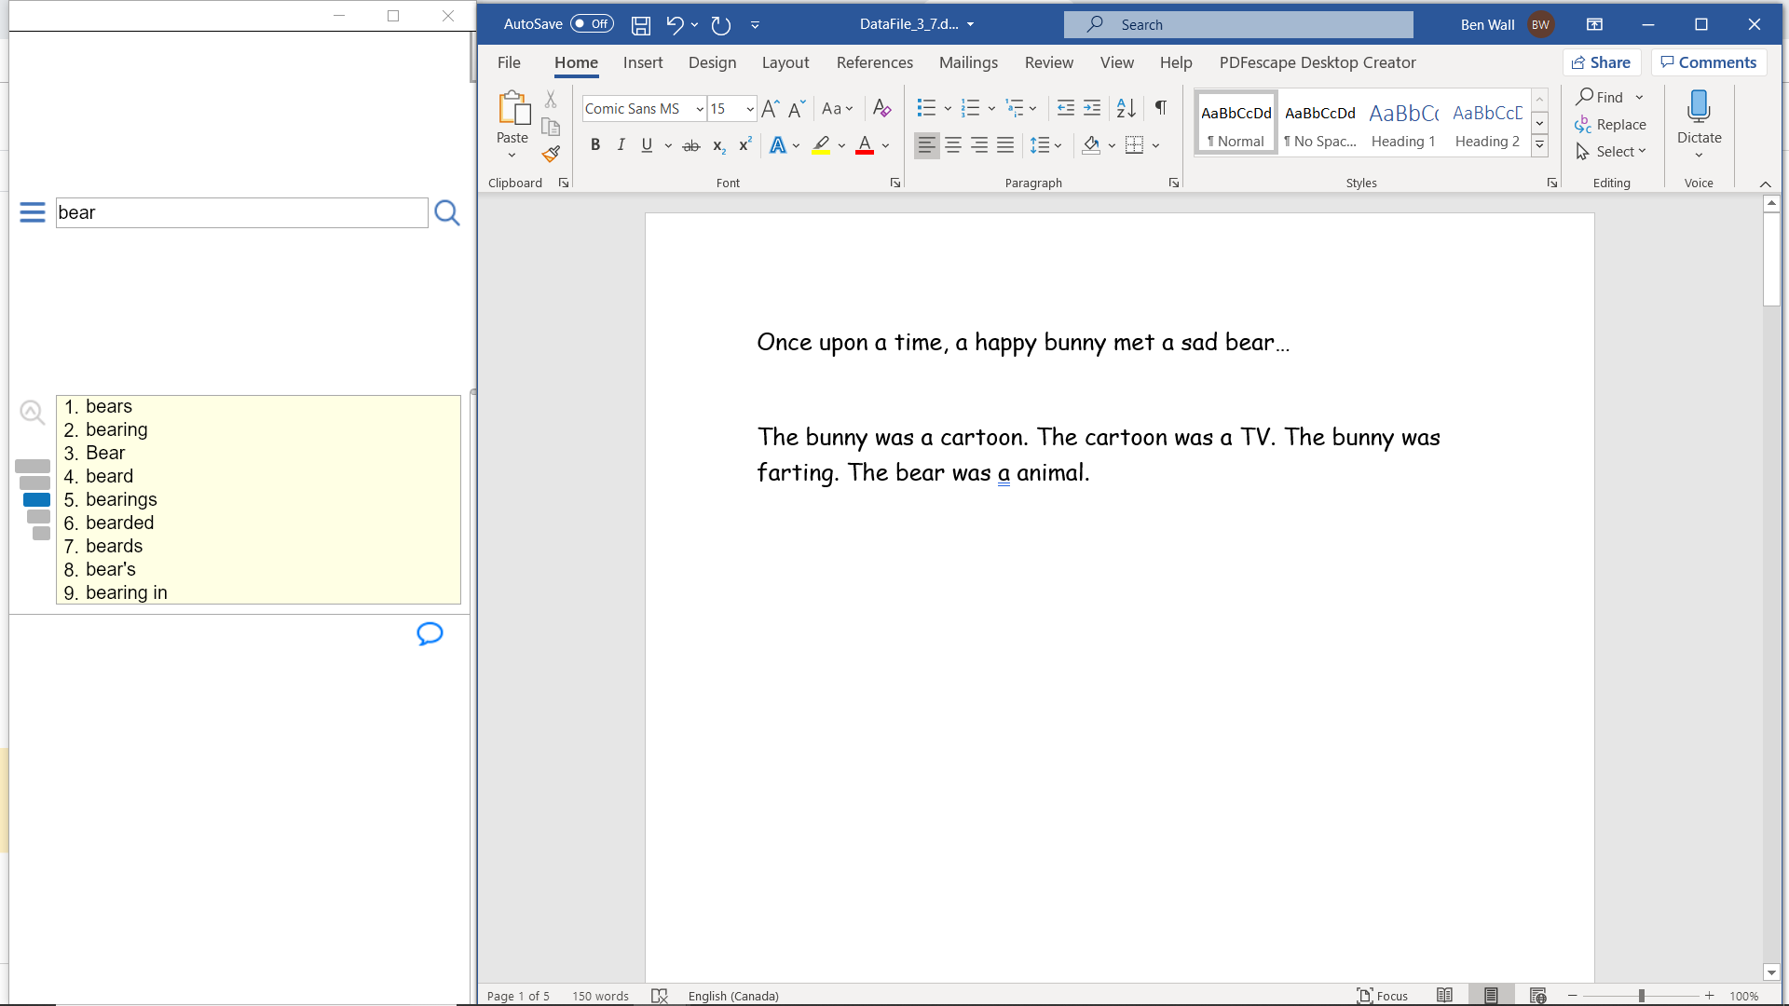

Slide 51
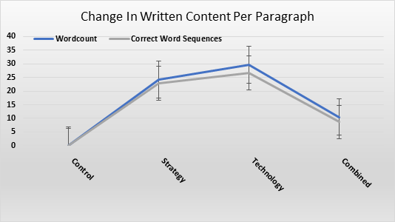
Results

Slide 52
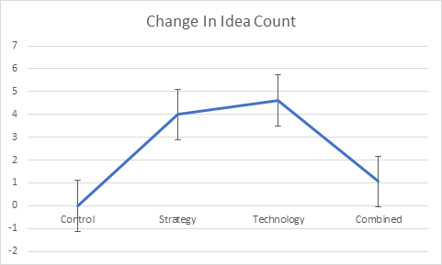
Results

Slide 53
Cognitive Load
Internal
Task specific
External
Environment specific
Germane
Related to learning and skill acquisition; schema development

Slide 54
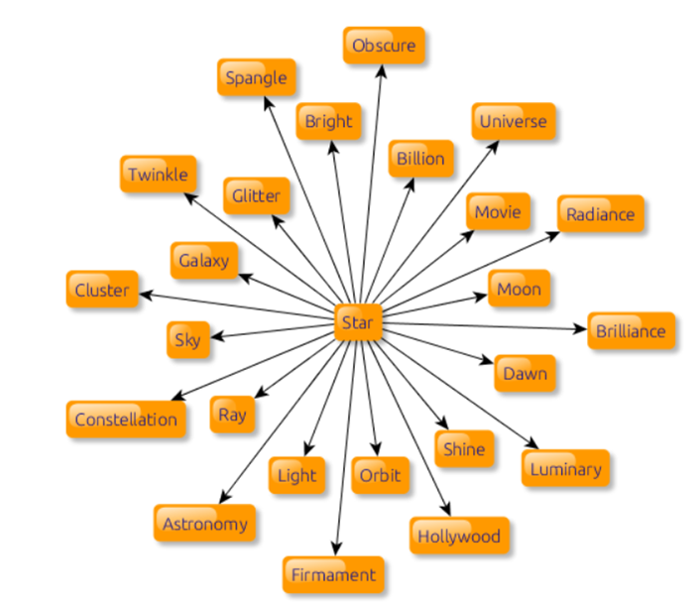
Should you use idea generators?

Slide 55
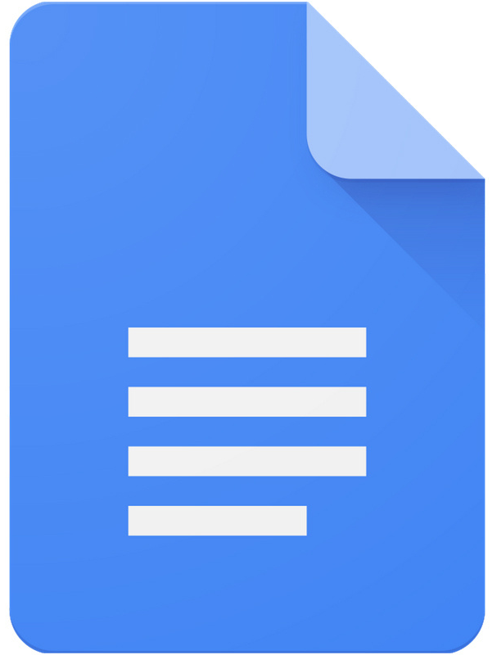
Editing Assistance
Notes:
Ask the audience:
Why do we use Editing Assistance?
What Editing Assistance programs do you use?
What works well for you?
Have you had any challenges?

Slide 56
Functions
Provide corrections, suggestions, and tips
Plagiarism-detection and proofreading functions
Training games
AI developed by experts in linguistics

Slide 57
Claims Challenges
Useful for students who struggle with grammar or who are new English Language Learners
Penalize grammatical edits that are correct but not in the gold standard and over-identifying “errors”
(Napoles, Sakaguchi & Tetreault, 2016)

Slide 58
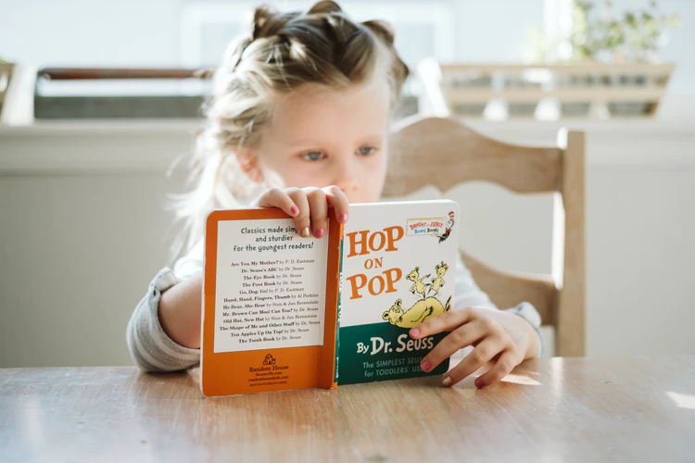
Classroom Challenges
Notes:
Ability to read and understand what is being suggested
Evaluate correctness of suggestions
Age of student
Executive functions
EF to not just accept all changes

Slide 59
Editing Assistance Mini-Study (April 2019)
Sentences
Editing Assistance Programs
Compare Effectiveness
Written by ELL students as part of a larger study
Grammarly caught the most errors by far, however the humans were still far superior
Ginger made the most incorrect corrections
Grammarly, Ginger, MS Word, and Google Docs
Compared to human raters

Slide 60
The brid is sing.

Slide 61
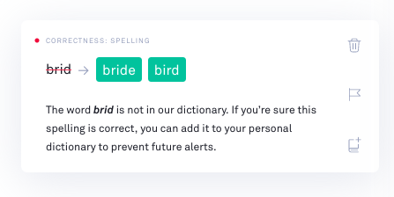
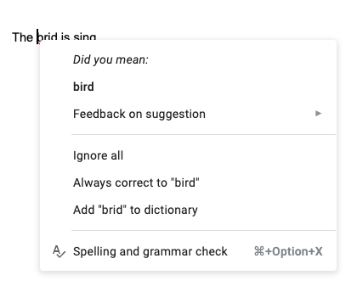
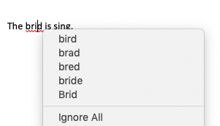
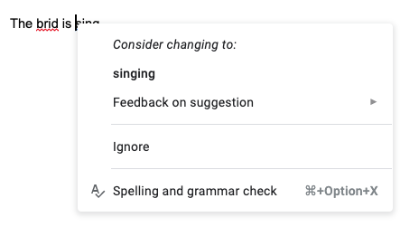

Slide 62
Ginger

Slide 63
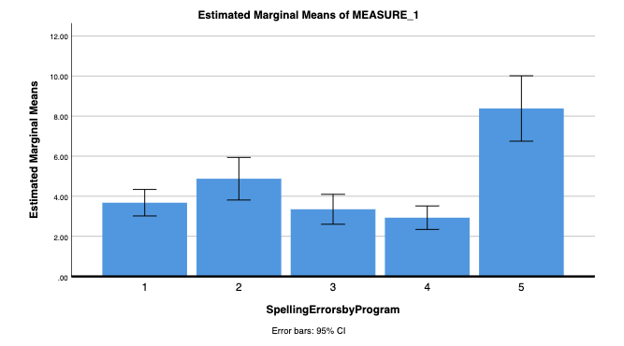
Spelling Errors
* p < .001
Average Number of Errors
Grammarly Ginger Microsoft Word Google Docs Humans

Slide 64
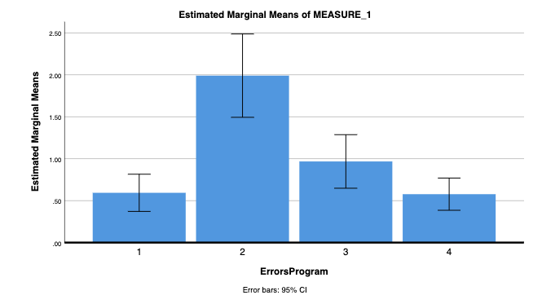
Errors that Change the Meaning of the Text
* p < .001
Average Number of Errors
Grammarly Ginger Microsoft Word Google Docs

Slide 65
So, what do we know about editing assistance?
Not created equal
Require strong EF skills
Not the be-all end-all
May not pick up really bad spelling errors
May be more useful for typical users who are not English language learners and do not have a learning disability.

Slide 66
Main Takeaways
Typing
Automaticity and fluency are key, so the more practice students have the better.
Voice Recognition
Greatest research support for Dragon 15, as it makes the least amount of errors.
Idea Generation
Early results show positive impact on short written paragraphs and demonstrated potential to support students’ written expression
Editing Assistance
Ensure that students review recommended changes before accepting them. Grammarly currently has the most research support.
Notes:
**not recommend, more of a “research is showing that …”
Think about training model, strategy first or technology first

Slide 67
Questions?

Slide 68
Bronwyn Lamond, MA, OCT
bronwyn.lamond@mail.utoronto.ca
Francis Wall, BSc.
francis.wall@mail.utoronto.ca
Emily Staffiere, BSc.
emily.staffiere@mail.utoronto.ca
Todd Cunningham, PhD. C.Psych
todd.cunningham@utoronto.ca
@atselect_oise
@atselect_oise
Academic Intervention Lab
www.Academic
InterventionLab.com

Slide 69
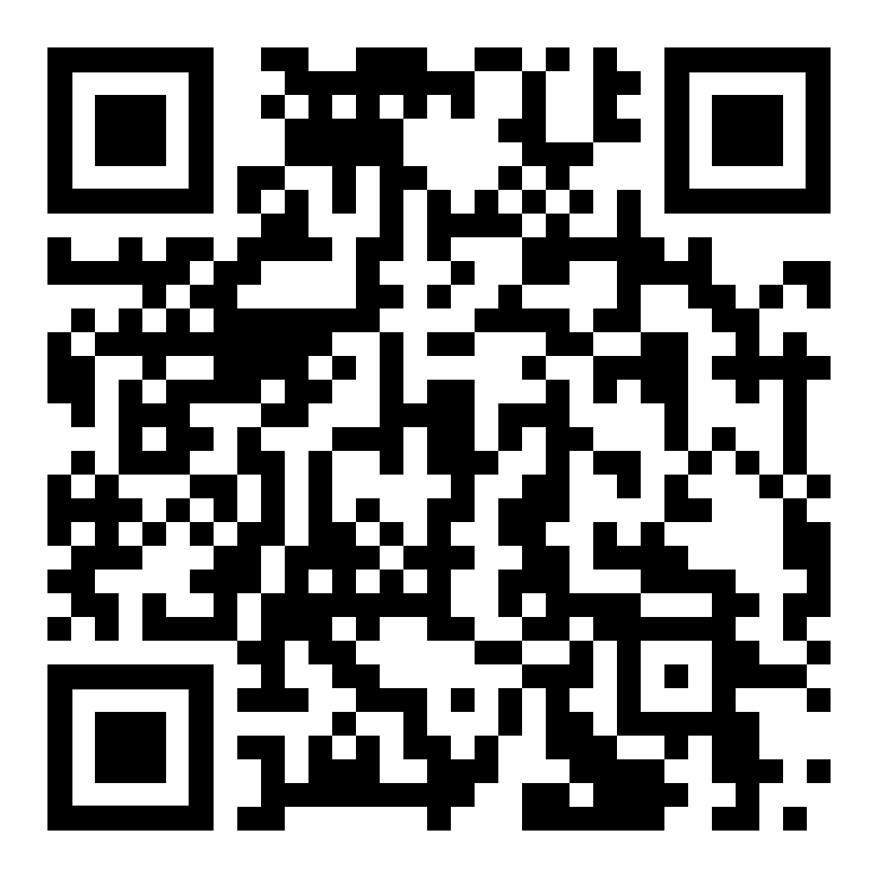
We’d love your feedback!
OR
http://tiny.cc/zob3fz

